Slide 1
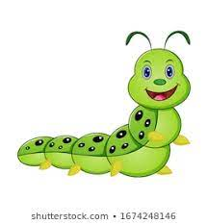
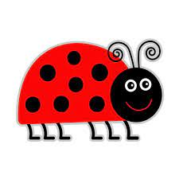


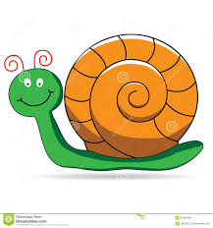
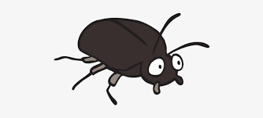

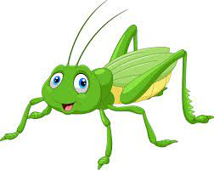
Friends in the garden – sing to ‘Baa, baa black sheep’
Here comes ladybird on a sunny day
Caterpillar sees her on his way
Sweet little butterfly waves to the bee
As they fly around the apple tree.
Here’s a cricket dancing on a log
He’s performing for a frog
Black shiny beetle follows the snail
Knows he’ll find him by his silver trail.

Slide 2
Here comes on a sunny day
sees her on his way
Sweet little waves to the
As they fly around the apple tree
Here’s a dancing on a log
He’s performing for a
Black shiny follows the
Knows he’ll find him by his silver trail

Slide 3
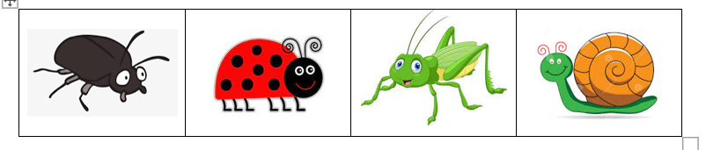
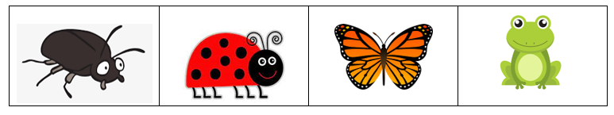


Rhythm phrases to echo
1
2
3
4

Slide 4

Piano piece: In the garden
Listen out for these three rhythms, after the introduction

Slide 5
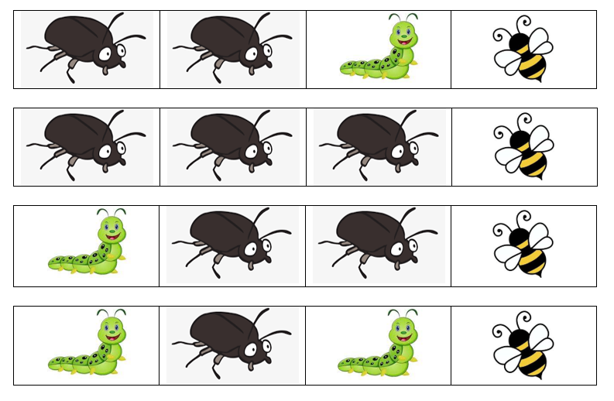
Play the four rhythmic phrases to accompany the piano piece.
The rhythms are heard in the melody...
Wait for the introduction!

Slide 6


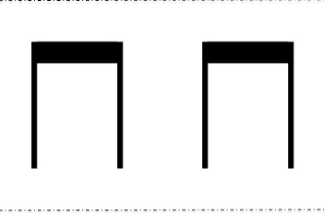

Graphic symbols to match to stick notation

Slide 7
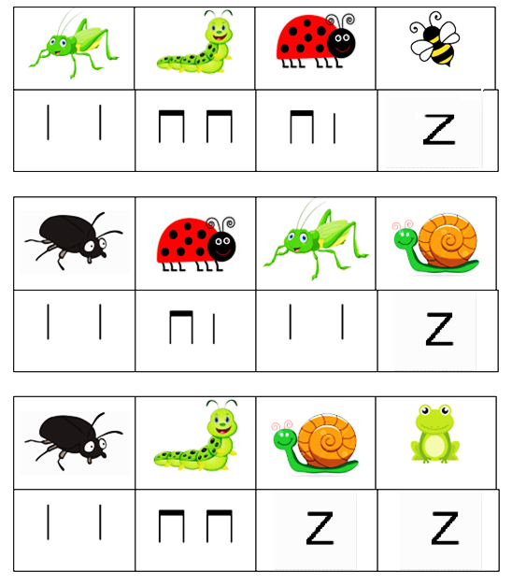

Slide 8

Choose stick notation symbols to create and play an ostinato rhythm

Slide 9
Play your score to accompany the piano piece.
Remember to play it 4 times, beginning after the introduction

